Slide 1
Establishing Hierarchy using Color and Type

Slide 2
Visual Hierarchy
Contrast
Subtlety

Slide 3
What is Hierarchy?

Slide 4
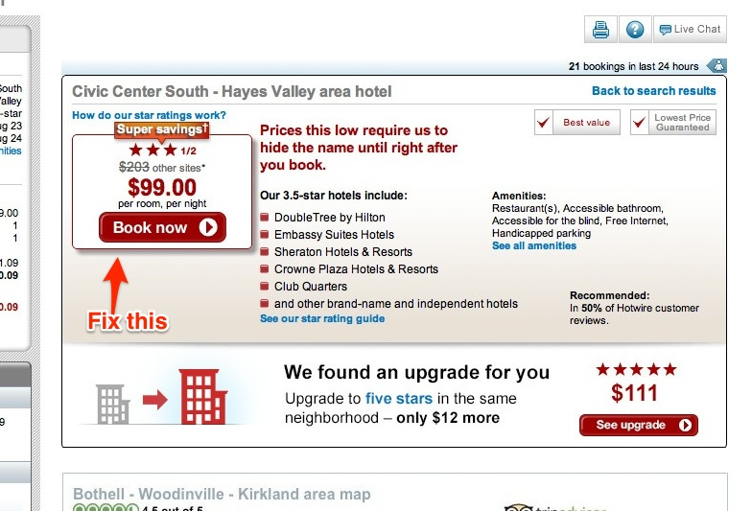

Slide 5
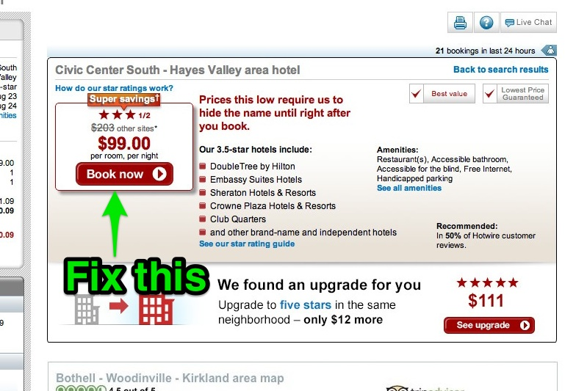

Slide 6


Slide 13
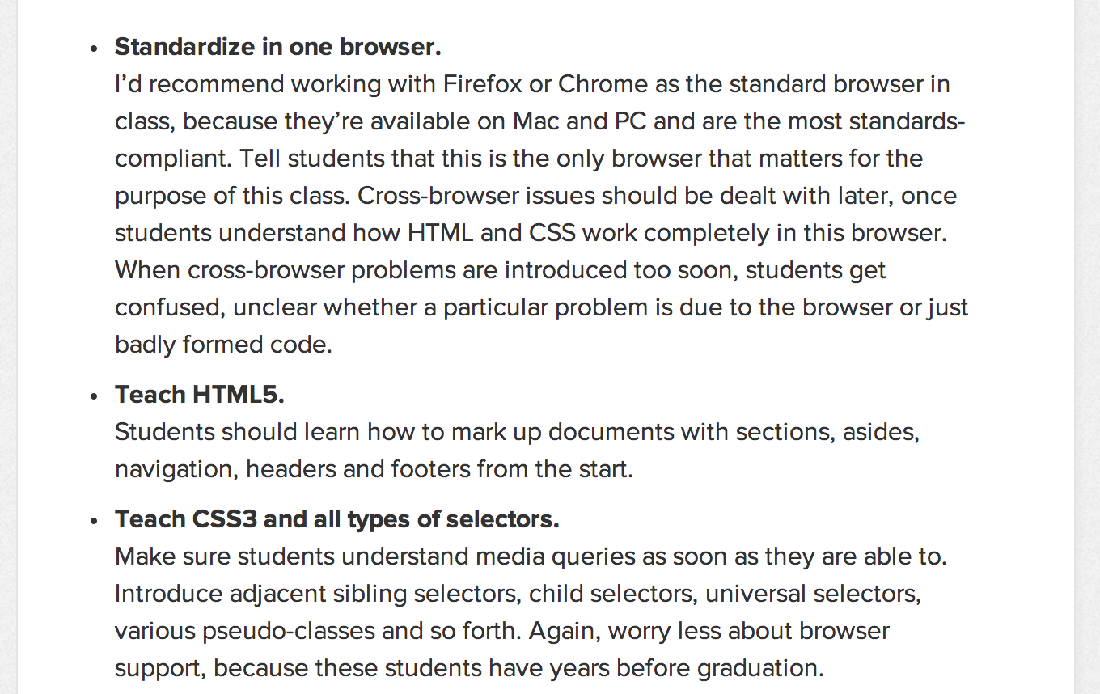

Slide 14


Slide 15
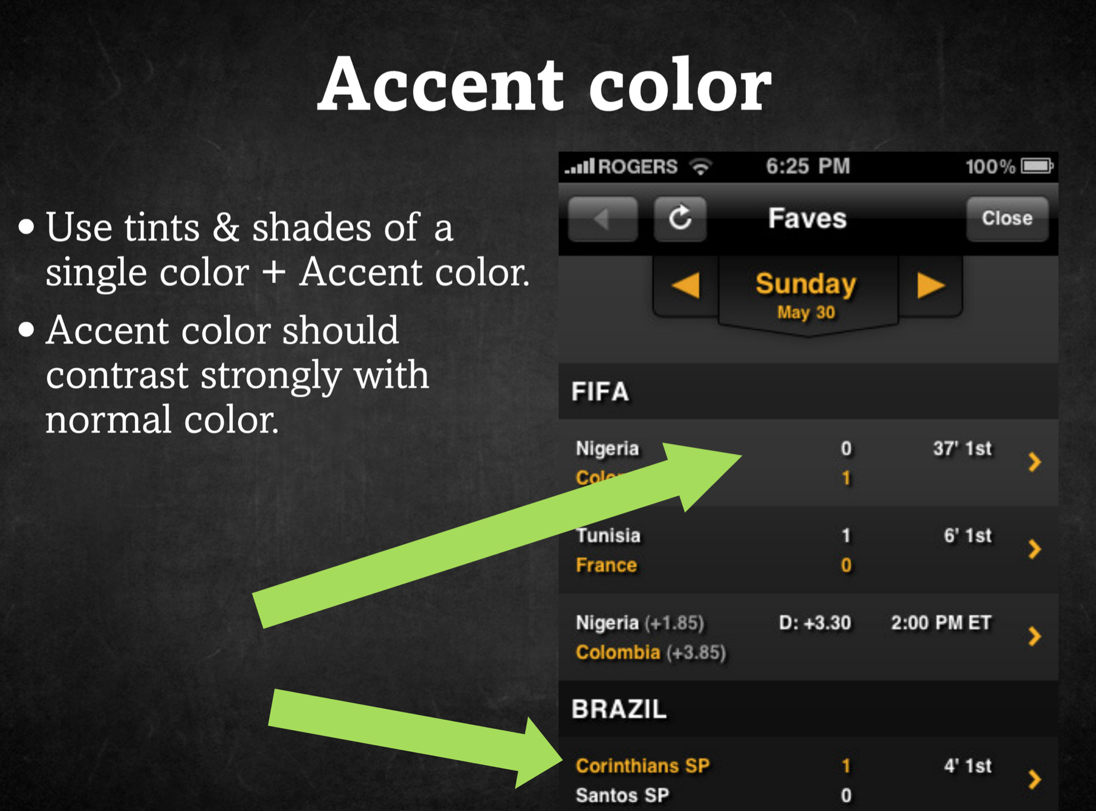

Slide 16


Slide 17
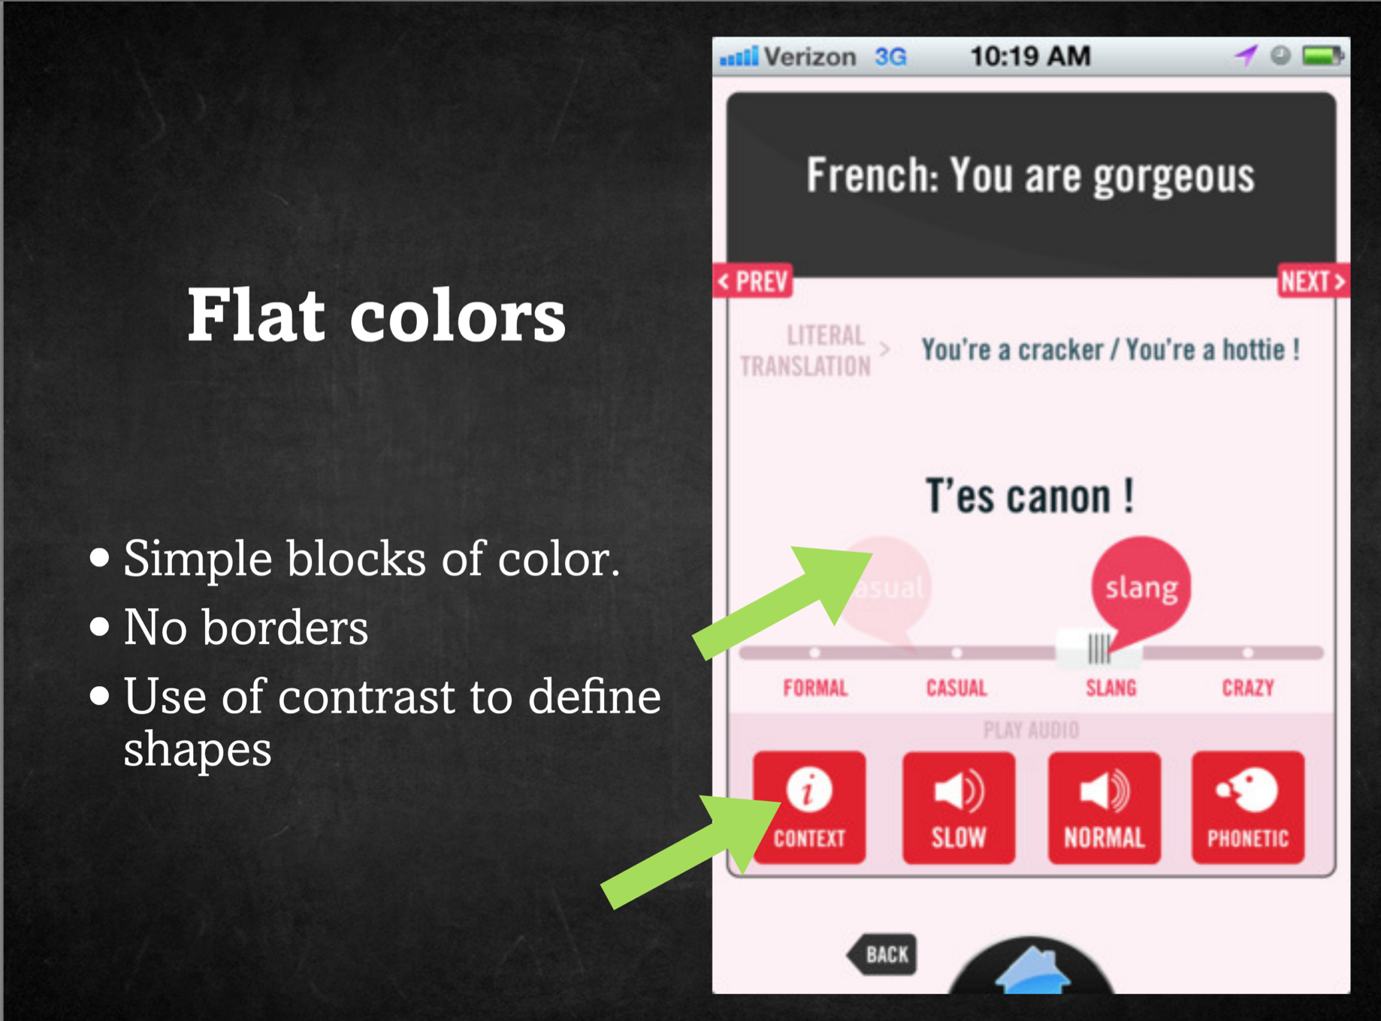

Slide 18
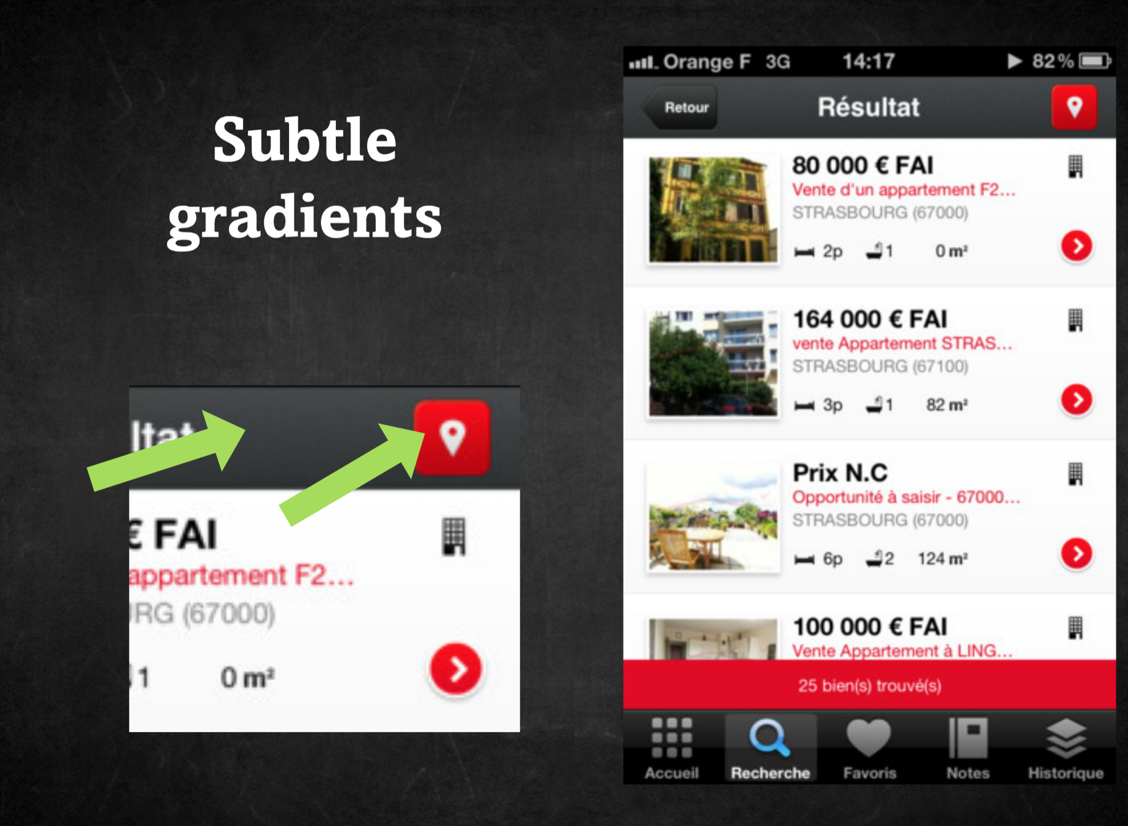

Slide 19
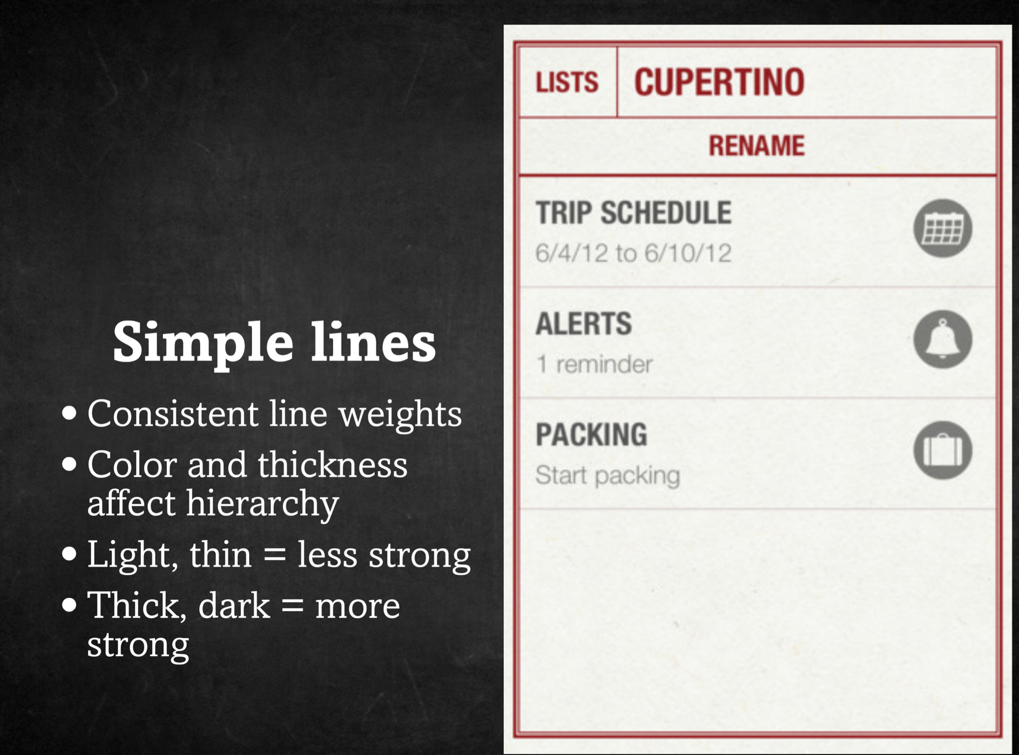

Slide 20


Slide 21


Slide 22
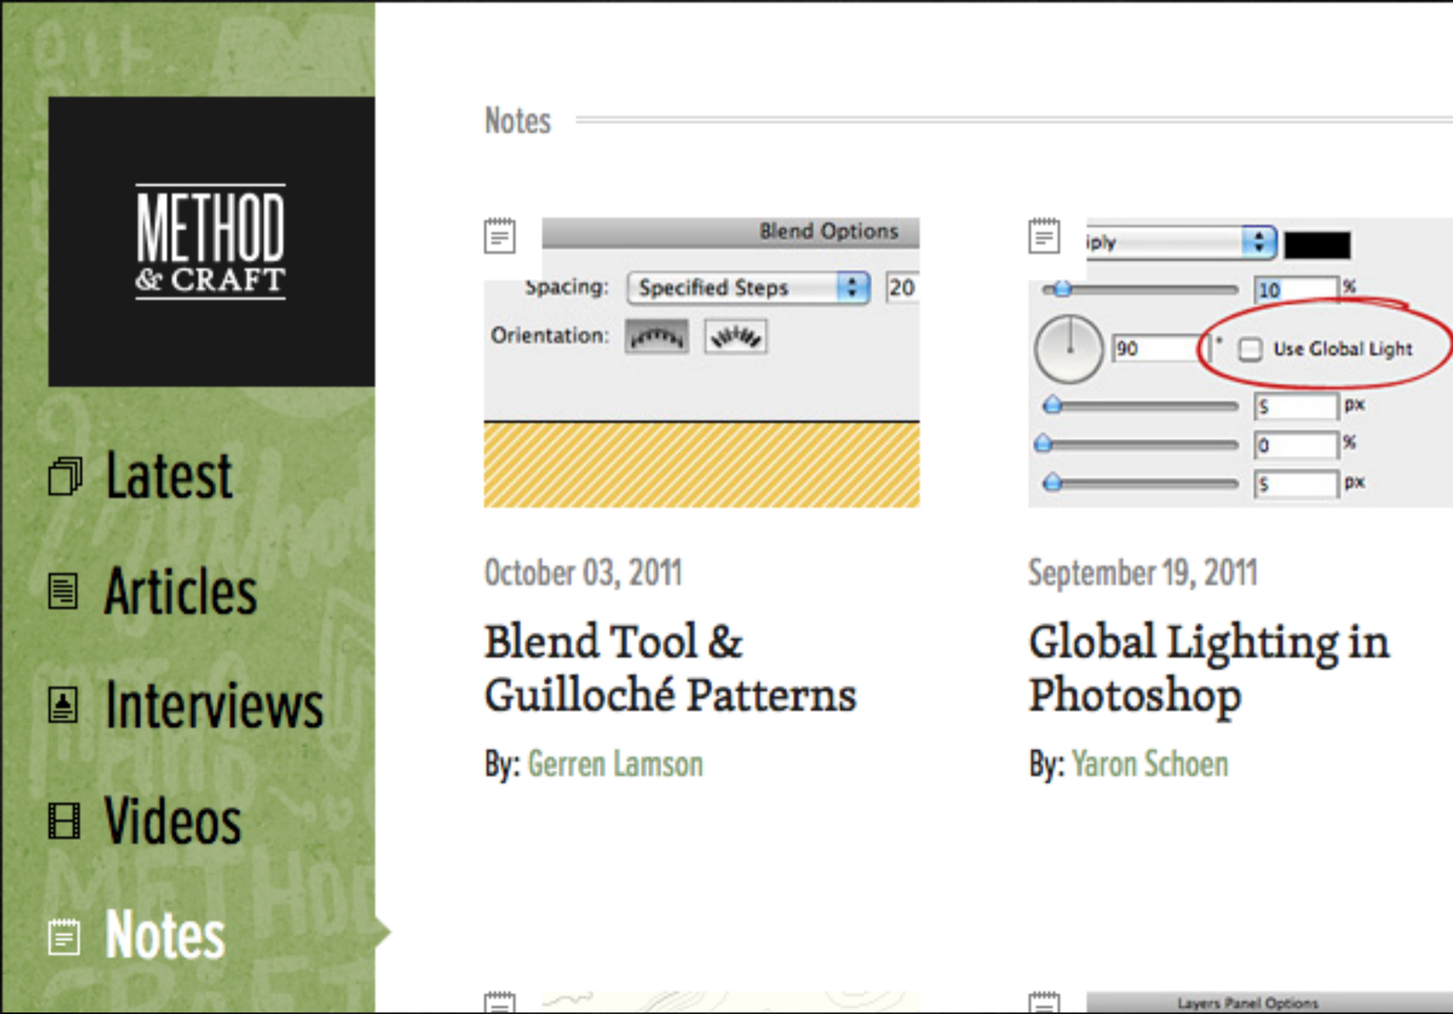

Slide 24
Review
Visual Hierarchy
Contrast
Subtlety

